Slide 1

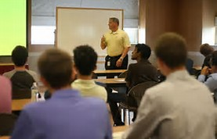

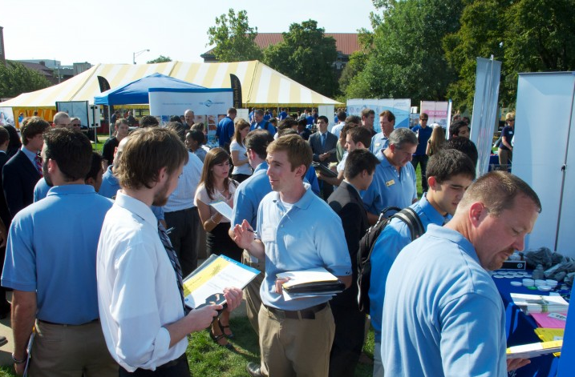
PESC presents the annual Industrial Roundtable
Seminar Presentations:
-Mon. September 12th
-2nd and 3rd floor of Stewart Center
-74 companies presenting and all students are welcome:
Caterpillar
Fiat Chrysler Automotive
John Deere
IBM
Stryker
SpaceX
Walt Disney Company
Pepsi Co.
-Great opportunity to get face time with company representatives before fair
Career Fair:
-Tues. Sept. 13th & Wed. Sept. 14th
-Location: Memorial Mall
-Dress: Business Casual
-What to Bring: Resume, Elevator Speech
-How to Prepare:
Attend IR Prep Night (Wed - 09/7) and International Student Workshop (Tues - 9/6)
Go to Seminar Presentations (09/12)
Research companies of interest
Apply online when possible
Have a plan of who you want to talk to during the fair
Get the IR “Purdue Career Fair Plus” Fair App (For Android & iPhone)

